Slide 1
CPSC 583 Expert Systems Design Theory
Dr. Anand Panangadan
apanangadan@fullerton.edu
Some slides are adapted from:
I. Bratko (Addision Wesley)
W. F. Clocksin
J. Stelovsky
Prolog tutorial: https://www.cpp.edu/~jrfisher/www/prolog_tutorial/contents.html

Slide 2
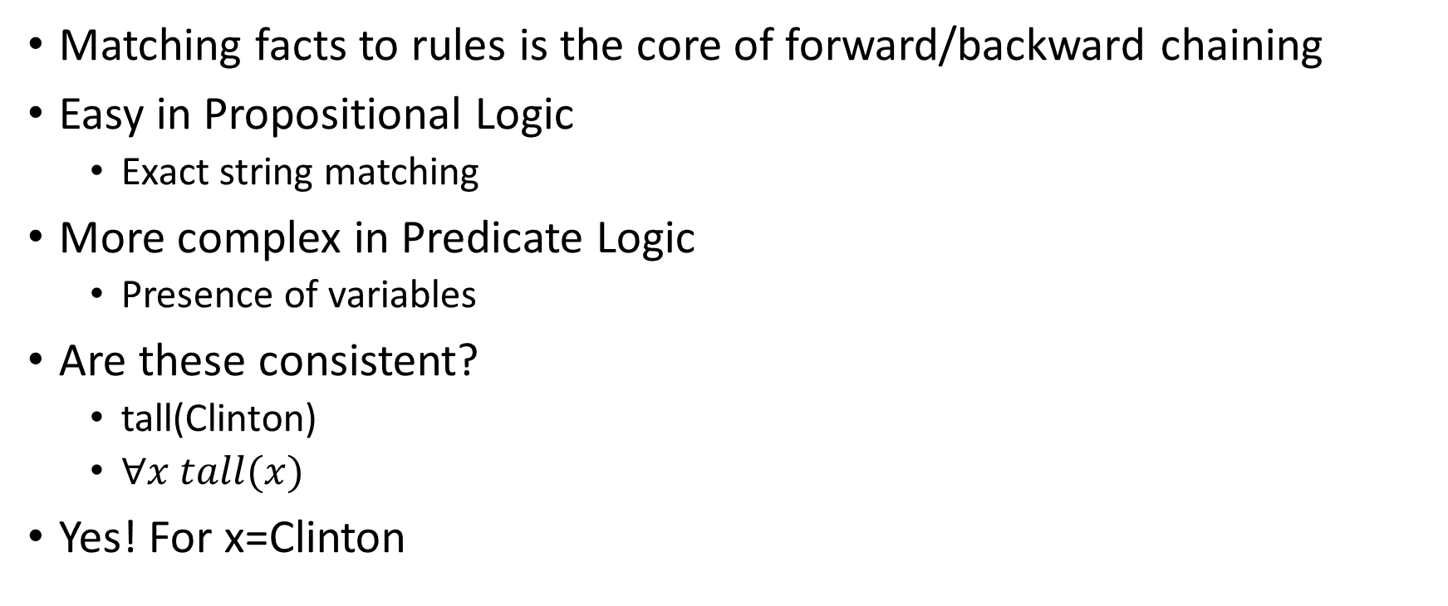
Matching facts to rules during inferencing
Matching facts to rules is the core of forward/backward chaining
Easy in Propositional Logic
Exact string matching
More complex in Predicate Logic
Presence of variables
Are these consistent?
tall(Clinton)
$∀x tall(x)$
Yes! For x=Clinton

Slide 3
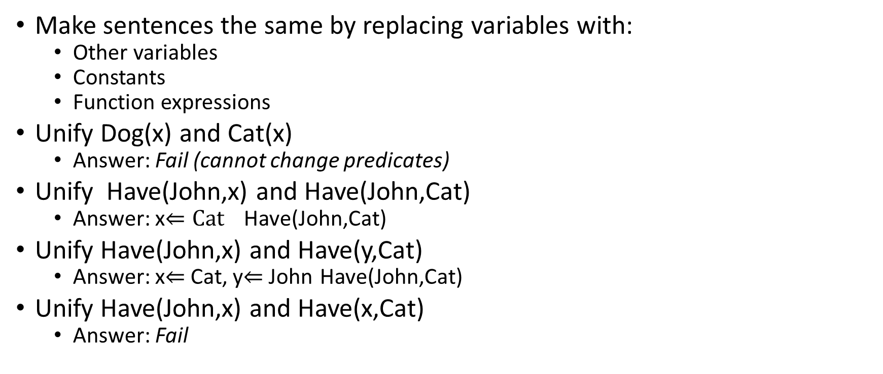
Unification
Make sentences the same by replacing variables with:
Other variables
Constants
Function expressions
Unify Dog(x) and Cat(x)
Answer: Fail (cannot change predicates)
Unify Have(John,x) and Have(John,Cat)
Answer: x$⇐Cat$ Have(John,Cat)
Unify Have(John,x) and Have(y,Cat)
Answer: x$⇐$Cat, y$⇐$John Have(John,Cat)
Unify Have(John,x) and Have(x,Cat)
Answer: Fail

Slide 4
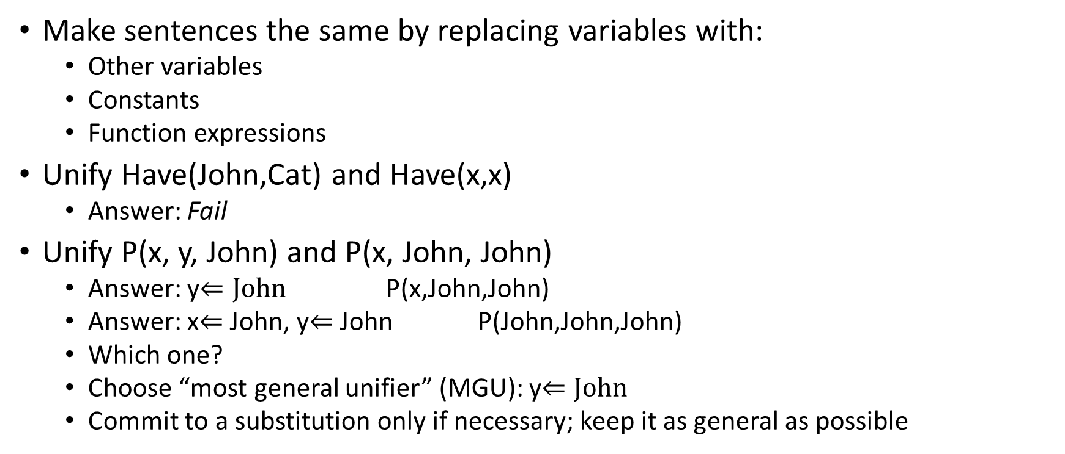
Unification
Make sentences the same by replacing variables with:
Other variables
Constants
Function expressions
Unify Have(John,Cat) and Have(x,x)
Answer: Fail
Unify P(x, y, John) and P(x, John, John)
Answer: y$⇐John$ P(x,John,John)
Answer: x$⇐$John, y$⇐$John P(John,John,John)
Which one?
Choose “most general unifier” (MGU): y$⇐John$
Commit to a substitution only if necessary; keep it as general as possible

Slide 5
Unification algorithm
Input
A pair of predicate logic expressions
Output
Most General Unifier (MGU) if possible
Fail otherwise
Recursive algorithm
Represent the expression as a list
Process the list from the head
Determine a substitution to the head of the list
Apply substitution to the rest of the list
Recurse on the rest of the list

Slide 6
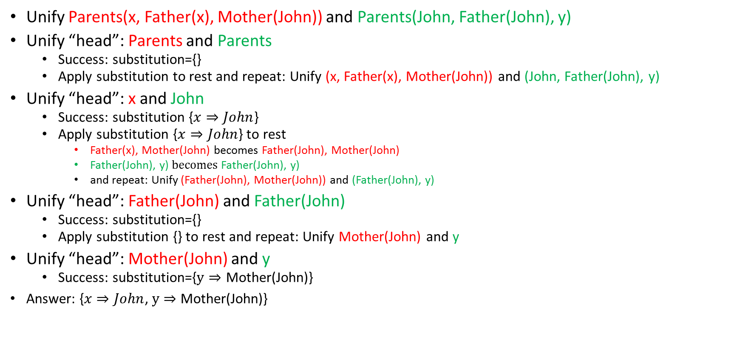
Unification algorithm example
Unify Parents(x, Father(x), Mother(John)) and Parents(John, Father(John), y)
Unify “head”: Parents and Parents
Success: substitution={}
Apply substitution to rest and repeat: Unify (x, Father(x), Mother(John)) and (John, Father(John), y)
Unify “head”: x and John
Success: substitution {$x⇒John$}
Apply substitution {$x⇒John$} to rest
Father(x), Mother(John) becomes Father(John), Mother(John)
Father(John), y) $becomes$Father(John), y)
and repeat: Unify (Father(John), Mother(John)) and (Father(John), y)
Unify “head”: Father(John) and Father(John)
Success: substitution={}
Apply substitution {} to rest and repeat: Unify Mother(John) and y
Unify “head”: Mother(John) and y
Success: substitution={$y⇒$ Mother(John)}
Answer: {$x⇒John$, $y⇒$ Mother(John)}

Slide 7
Class work
Unify the following pairs of predicate logic expressions
variables start with a small letter, Constants start with a Capital letter
Determine if unification fails, or if it succeeds give the substitution
Dog(x), Dog(Rover)
Child(x,y), Child(Pat, Jim)
Child(x,y), Child(Pat, z)
Child(x,Jim), Child(Pat, y)
Child(x,Jim), Child(x, Pat)
Child(x,Jim), Child(Pat, Father-of(Pat))
Child(x,Father-of(x)), Child(Pat, Father-of(Pat))
Child(x,Father-of(x)), Child(Pat, y)

Slide 8
Prolog
Most widely used language to have been inspired by logic.
Unification is built-in
passes parameters, returns results, selects and constructs data structures.
Basic control flow is backtracking
Program clauses and data have the same form.

Slide 9
Defining relations
The arguments of relations can be
Atoms: constants
Variables: begin with a capital letter (X, Y, Diagnosis) or underscore (_X, _Diagnosis, _)
A Prolog program consists of clauses. Each clause terminates with a period.
The user can query the Prolog system about relations defined in the program.
Questions to the system consist of one or more goals.
An answer to a question can be either true (succeeded) or false (failed).
If multiple answers satisfy the question then Prolog will find as many of them as desired by the user.

Slide 10
SWI-Prolog
http://www.swi-prolog.org/

Slide 11
Python - Prolog bridge
Use Python for UI
Get the facts from the world
Use Prolog only as the “Inference engine”
Get answers to logical queries
Query answers are integrated into the rest of the application
https://github.com/yuce/pyswip

Slide 12
How to ask a question
Write a prolog program in a .pl file.
Load the file, using the prolog interpreter:
consult command:
?- consult(‘file.pl’).
To reload the same program, use make.
?- make.
Then ask questions to the interpreter.
To exit, use command:
?- halt.

Slide 13
Structure of Programs
Programs consist of procedures.
Procedures consist of clauses.
Each clause is a fact or a rule.
Programs are executed by posing queries.

Slide 14
Example
Predicate
Facts
elephant(george).
elephant(mary).
Clauses

Slide 15
Example
?- elephant(george).
true
?- elephant(jane).
false
Queries
Replies

Slide 16
Body of a rule clause contains goals.
Head
Body
likes(mary, X) :- human(X), honest(X).
Goals
‘if’
‘provided that’

Slide 17
Prolog clauses
Prolog clauses consist of
Head
Body: a list of goals separated by commas (,)
Prolog clauses are of three types:
Facts:
declare things that are always true
facts are clauses that have a head and the empty body
Rules:
declare things that are true depending on a given condition
rules have the head and the (non-empty) body
Questions:
the user can ask the program what things are true
questions only have the body

Slide 18
Defining relations by facts
Given a whole family tree
The tree defined by the Prolog program:
parent( pam, bob). % Pam is a parent of Bob
parent( tom, bob).
parent( tom, liz).
parent( bob, ann).
parent( bob, pat).
parent( pat, jim).
pam
tom
bob
liz
ann
pat
jim

Slide 19
Defining relations by facts
Questions:
Is Bob a parent of Pat?
?- parent( bob, pat).
?- parent( liz, pat).
?- parent( tom, ben).
Who is Liz’s parent?
?- parent( X, liz).
Who are Bob’s children?
?- parent( bob, X).
pam
tom
bob
liz
ann
pat
jim

Slide 20
Defining relations by facts
pam
tom
Questions:
Who is a parent of whom?
Find X and Y such that X is a parent of Y.
?- parent( X, Y).
Who is a grandparent of Jim?
?- parent( Y, jim),
parent( X, Y).
bob
liz
ann
pat
jim
X
parent
Y
grandparent
parent
jim

Slide 21
Defining relations by facts
Questions:
Who are Tom’s grandchildren?
?- parent( tom, X),
parent( X, Y).
Do Ann and Pat have a common parent?
?- parent( X, ann),
parent( X, pat).
tom
pam
bob
liz
ann
pat
jim

Slide 22
Defining relations by rules
Facts:
female( pam). % Pam is female
female( liz).
female( ann).
female( pat).
male( tom). % Tom is male
male( bob).
male( jim).
Define the “child” relation:
Fact: child( liz, tom).
Rule: child( Y, X) :- parent( X, Y).
For all X and Y,
Y is a child of X if
X is a parent of Y.
pam
tom
bob
liz
ann
pat
jim

Slide 23
Defining relations by rules
Rules have:
A condition part (body)
the right-hand side of the rule
A conclusion part (head)
the left-hand side of the rule
Example:
child( Y, X) :- parent( X, Y).
The rule is general in the sense that it is applicable to any objects X and Y.
A special case of the general rule:
child( liz, tom) :- parent( tom, liz).
?- child( liz, tom).
?- child( X, Y).
X
parent
child
Y

Slide 24
Defining relations by rules
Define the “mother” relation:
mother( X, Y) :- parent( X, Y), female( X).
For all X and Y,
X is the mother of Y if
X is a parent of Y and
X is a female.
female
X
parent
mother
Y

Slide 25
Defining relations by rules
Define the “grandparent” relation:
grandparent( X, Z) :-
parent( X, Y), parent( Y, Z).
X
parent
Y
grandparent
parent
Z

Slide 26
Class work: define the “sister” relation
X is a sister of Y if they have the same parent and X is female
Z
parent
parent
X
Y
female
sister

Slide 27
Class work: define the “sister” relation
X is a sister of Y if they have the same parent and X is female
X and Y should not be the same person!
X \== Y
Z
parent
parent
X
Y
female
sister

Slide 28
Recursive rules
Define the “ancestor” relation
X
X
parent
ancestor
parent
Y
Y1
parent
ancestor
X
Y2
parent
Y
ancestor
parent
parent
Z
Z

Slide 29
Recursive rules
Define the “ancestor” relation
ancestor( X, Z):- parent( X, Z).
ancestor( X, Z):-
parent( X, Y), ancestor( Y, Z).
For all X and Z,
X is a ancestor of Z if
there is a Y such that
(1) X is a parent of Y and
(2) Y is a ancestor of Z.
?- ancestor( pam, X).
X
parent
Y1
ancestor
ancestor
:
Z

Slide 30
Recursive rules
There are two “predecessor relation” clauses.
ancestor( X, Z) :- parent( X, Z).
ancestor( X, Z) :- parent( X, Y), ancestor( Y, Z).
Such a set of clauses is called a procedure.

Slide 31
Declarative and procedural meaning of programs
Clauses can be given a declarative or a procedural interpretation
Form of clause:
H :- G₁, G₂, …, G_{n}.
“That H is provable follows from goals G₁, G₂, …, G_{n} being provable.”
Declarative reading:
Procedural reading:
“To execute procedure H, the procedures called by goals G₁, G₂, …, G_{n} are executed first.”

Slide 32
Declarative and procedural meaning of programs
The declarative meaning
concerned only with the relations defined by the program
determines what will be the output of the program
The programmer should concentrate mainly on the declarative meaning and avoid being distracted by the executional details.
The procedural meaning
determines how this output is obtained
determines how the relations are actually evaluated by the Prolog system
The procedural aspects cannot be completely ignored by the programmer for practical reasons of executional efficiency.

Slide 33
How Prolog answers questions
To answer a question, Prolog tries to satisfy all the goals.
To satisfy a goal means to demonstrate that the goal is true.
Prolog accepts facts and rules as a set of axioms, and the user’s question as a conjectured theorem.
Example:
Axioms: All men are fallible.
Socrates is a man.
Theorem: Socrates is fallible.
For all X, if X is a man then X is fallible.
fallible( X) :- man( X).
man( socrates).
?- fallible( socrates).

Slide 34
How Prolog answers questions: Backtracking
Instantiation
Assigning temporary values to variables in propositions
Unification
Finding such values for variables so that matching/instantiation to succeeds
When
a variable is instantiated with a value, and then
matching fails
Then
unification needs to backtrack
the variable is instantiated with a different value

Slide 35
Unification
Two terms unify if substitutions can be made for any variables in the terms so that the terms are made identical. If no such substitution exists, the terms do not unify.
The Unification Algorithm proceeds by recursive descent of the two terms.
Constants unify if they are identical
Variables unify with any term, including other variables
Compound terms unify if their functors and components unify.

Slide 36
How Prolog answers questions: Backtracking
ancestor( X, Z) :- parent( X, Z). % Rule R1
ancestor( X, Z) :- parent( X, Y), % Rule R2
ancestor( Y, Z).
?- ancestor( tom, pat).
Finding a proof sequence:
First try that clause which appears first in the program. (Rule R1)
Now, X= tom, Z = pat.
The goal ancestor( tom, pat) is then replaced by parent( tom, pat).
There is no clause in the program whose head matches the goal parent( tom, pat).
Prolog backtracks to the original goal in order to try an alternative way (Rule R2).
parent( pam, bob).
parent( tom, bob).
parent( tom, liz).
parent( bob, ann).
parent( bob, pat).
parent( pat, jim).
pam
tom
bob
liz
ann
pat
jim

Slide 37
How Prolog answers questions
ancestor( X, Z) :- parent( X, Z). % Rule R1
ancestor( X, Z) :- parent( X, Y), % Rule R2
ancestor ( Y, Z).
?- ancestor( tom, pat).
Apply Rule R2, X = tom, Z = pat, but Y is not instantiated yet.
The top goal ancestor( tom, pat) is replaced by two goals:
parent( tom, Y)
ancestor( Y, pat)
The first goal matches one of the facts. (Y = bob)
The remaining goal has become
ancestor( bob, pat)
Using rule R1, this goal can be satisfied.
ancestor( bob, pat) :- parent( bob, pat)
parent( pam, bob).
parent( tom, bob).
parent( tom, liz).
parent( bob, ann).
parent( bob, pat).
parent( pat, jim).
pam
tom
bob
liz
ann
pat
jim

Slide 38
How Prolog answers questions
ancestor( tom, pat)
By rule R1
By rule R2
parent( tom, pat)
parent( tom, Y)
ancestor( Y, pat)
false
Y = bob
By fact
parent( tom, bob)
The top goal is satisfied when a path is found from the root node to a leaf node labeled ‘true’.
The execution of Prolog is the searching for such path.
ancestor( bob, pat)
By rule pr1
parent( pam, bob).
parent( tom, bob).
parent( tom, liz).
parent( bob, ann).
parent( bob, pat).
parent( pat, jim).
parent( bob, pat)
true
ancestor( X, Z) :- parent( X, Z). % Rule R1
ancestor( X, Z) :- parent( X, Y), % Rule R2
ancestor( Y, Z).
derivation diagrams

Slide 39
Class work: define the “maternal ancestor” relation
X is a maternal ancestor of Z if X is an ancestor of Z via Z’s mother
X
parent
Y1
parent
Y2
female
parent
Z

Slide 40
Lists and backtracking
Lists are useful when (implicitly) used with backtracking
[X|Y]
A list with first element as X and tail as Y
Using lists example:
member(X,[X|R]).
member(X,[Y|R]) :- member(X,R).
?- member(X, [10, 20, 30]).

Slide 41
Lists and backtracking
Writing a reverse procedure
?- reverse([10, 20, 30], X).
Accumulating parameter
a list variable to store intermediate results

Slide 42
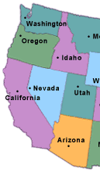
Representing a symmetric relation
oregon
california
nevada
arizona
How to represent this relation?
Borders are symmetric.

Slide 43
Representing a symmetric relation
The other direction?
(a) border(arizona, california).
border(nevada, california).
border(california, arizona).
border(california, nevada).
border(california, oregon).
border(nevada, arizona).
border(nevada, oregon).
(b)
adjacent(X, Y) :- border(X, Y).
adjacent(X, Y) :- border(Y, X).
(c)
border(X, Y) :- border(Y, X).

Slide 44
Procedural meaning of Prolog
Backtracking
The cut operator !
Negation-as-Failure
not

Slide 45
How to control backtracking
?- color(apple, X).
X = red;
X = green;
false.
color(cherry, red).
color(banana, yellow).
color(apple, red).
color(apple, green).
color(orange, orange).
…
What if only one color is needed?

Slide 46
The CUT
The cut is a built-in predicate written as !
The cut always succeeds
When backtracking over a cut, the goal that caused the current procedure to be used fails
Not used for its logical properties, but to control backtracking.

Slide 47
How CUT works
Suppose goal H is called, and has two clauses:
H₁ :- B₁,… B_{i}, !, B_{k},… B_{m}.
H₂ :- B_{n},… B_{p}.
If H₁ matches goals B₁...B_{i} are attempted and may backtrack among themselves
If B₁...B_{i} fails, H₂ will be attempted
But as soon as ! is crossed, Prolog commits to the current choice. All other choices are discarded.

Slide 48
Commitment to the Clause
H₁ :- B₁,… B_{i}, !, B_{k},… B_{m}.
H₂ :- B_{n},… B_{p}.
Goals B_{k}...B_{m} may backtrack amongst themselves, but
If goal B_{k} fails, then the predicate fails and the subsequent clauses are not matched

Slide 49
Uses of Cut: Specify Exclusion Cases
To specify exclusion of cases by ‘committing’ to the current choice.
Example: max(X, Y, Z) makes Z maximum of X and Y
max(X, Y, X) :- X >= Y.
max(X, Y, Y) :- X < Y.
Note: Both clauses are logically correct statements

Slide 50
Max with Cut
Using cut can get rid of the second test:
max(X, Y, X) :- X >= Y, !.
max(X, Y, Y).
If max is called with X ≥ Y, the 1st clause succeeds, and because of ! the 2nd clause isn't called
The advantage
The test isn't made twice if X<Y
The disadvantage
Each rule isn't a logically correct statement about the predicate.
A problem:
?- max(10, 0, 0).

Slide 51
Max with Cut
It is better to use ! and both tests:
max(X, Y, X) :- X >= Y, !.
max(X, Y, Y) :- X < Y.
This backtracks correctly and avoids unnecessary tests
Or, if order of clause may change:
max(X, Y, X) :- X >= Y, !.
max(X, Y, Y) :- X < Y, !.

Slide 52
Classwork
Show the execution trace for the following program:
max(X, Y, X) :- X >= Y, !.
max(X, Y, Y) :- X < Y, !.
Given the query:
?- max(10, 25, A).
?- max(100, 25, A).

Slide 53
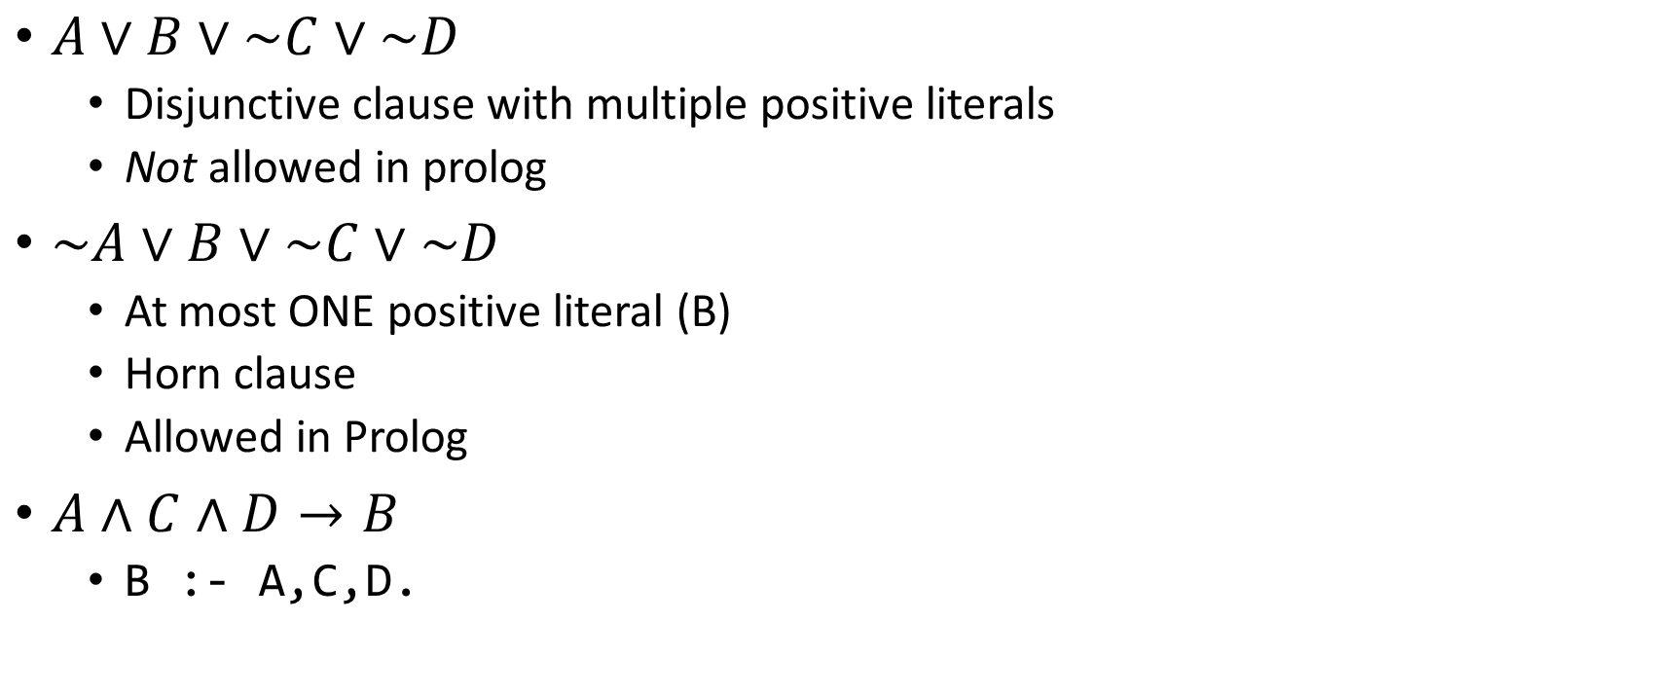
No real negation in Prolog
$A∨B∨\sim C∨\sim D$
Disjunctive clause with multiple positive literals
Not allowed in prolog
$\sim A∨B∨\sim C∨\sim D$
At most ONE positive literal (B)
Horn clause
Allowed in Prolog
$A∧C∧D→B$
B :- A,C,D.

Slide 54
Negation-as-Failure
Using cut together with the built-in predicate fail defines a kind of negation.
Examples:
Mary likes any animals except reptiles:
likes(mary,X) :- reptile(X), !, fail.
likes(mary,X) :- animal(X).
A utility predicate meaning something like “not equals”:
different(X, X) :- !, fail.
different(_, _).

Slide 55
Negation-as-Failure: not
We can use the idea of “cut fail” to define the predicate not, which takes a term as an argument
not “calls” the term, evaluating as if it was a goal:
not(G) fails if G succeeds
not(G) succeeds if G does not succeed.
In Prolog,
not(G) :- call(G), !, fail.
not(_).
call is a built-in predicate.

Slide 56
Negation-as-Failure: not
Most Prolog systems now have a built-in predicate not.
Also called \+.
\+ X = Y
X \= Y
not does not correspond to logical negation, because it is based on the success/failure of goals.
It can, however, be useful
likes(mary, X) :- not(reptile(X)), animal(X).
different(X, Y) :- not(X = Y).

Slide 57
Class work
Write a rule that defines the friend-of-a-friend (“foaf”) relationship for states:
Two states are “foaf” if they each share a border with some state but do not directly share a border.
E.g., California and Washington share a border with Oregon but do not directly border each other.
Use the list of borders defined earlier
Hint: use adjacent(_,_)

Slide 58






Misleading Negation-as-Failure
A student who missed some Prolog lectures was commissioned to write a Police Database system in Prolog
The database held the names of members of the public, marked by whether they are innocent or guilty of some offence
Suppose the database contains the following:
innocent(tweety_bird).
innocent(kitten).
innocent(spongebob).
guilty(beavis).
guilty(bart_simpson).
Consider the following dialogue:
?- innocent(mother_teresa).
false.

Slide 59
Problem – false may not mean FALSE
innocent(mother_teresa)?
Prolog produces false, because mother_teresa is not in the knowledgebase
Note: the knowledgebase is hidden from the user

Slide 60
not Makes Things Worse
Using not doesn't help
guilty(X) :- not(innocent(X)).
This makes matters even worse
?- guilty(mother_teresa).
true.
It is one thing to show that mother_teresa cannot be demonstrated to be innocent, but it is worse to incorrectly show that she is guilty!

Slide 61


Negation-as-Failure can be Non-Logical
More subtle than the innocent/guilty problem, NOT can lead to some obscure programming errors.
An example using a restaurant database
healthy(panera_bread).
healthy(subway).
expensive(panera_bread).
cheap(R) :- not(expensive(R)).
Consider query:
?- healthy(X), cheap(X).
X = subway.
But let's ask the logically equivalent question:
?- cheap(X), healthy(X).
false.

Slide 62
Why Different Answers?
Why different answers for logically equivalent queries?
?- healthy(X), cheap(X).
?- cheap(X), healthy(X).
In the 1st query, X is always instantiated when cheap(X) is executed
In the 2nd query, X is not instantiated when cheap(X) is executed
The semantics of cheap(X) differ depending on whether its argument is instantiated!

Slide 63
Prolog and Predicate Logic
Resolution order control
Cut used for efficiency, but violates declarative style
Closed-world assumption
Atomic sentences not known to be TRUE are FALSE
Assumption not made in Predicate Logic
The negation problem
Is a proposition FALSE if it can’t be proven TRUE?
Intrinsic efficiency limitations
Not meant for complex numerical calculations

Slide 64
Advantages of Prolog
Programs based on logic
More logically organized and written
Backtracking is naturally parallel
Prolog interpreters can take advantage of multiprocessor machines
Programs are concise
Fewer lines of code necessary
Development time is decreased – good for prototyping

Slide 65
Traditional applications of Logic Programming
Expert and knowledge-based systems
Natural language processing

Slide 66
Newer applications of Logic Programming
Combination of a declarative language with a Semantic Web framework
Managing privacy policies for handling data in the enterprise
Representing access control policies for users

Slide 67
Inferencing Processes
Top-down resolution, backward chaining
Begin with goal and attempt to find sequence that leads to set of facts in database
Works well with a small set of possibly correct answers
Prolog uses backward chaining
Bottom-up resolution, forward chaining
Begin with facts and rules of database and attempt to find sequence that leads to goal
Works well with a large set of possibly correct answers
CLIPS uses forward chaining

